Slide 1
A Reconstruction of Raphael's 1963 Semantic Question Answering System
Project by: Pratik Joshi
Project Mentor: Prof. Ashwin Srinivasan

Slide 2
Raphael’s System Overview

Slide 3
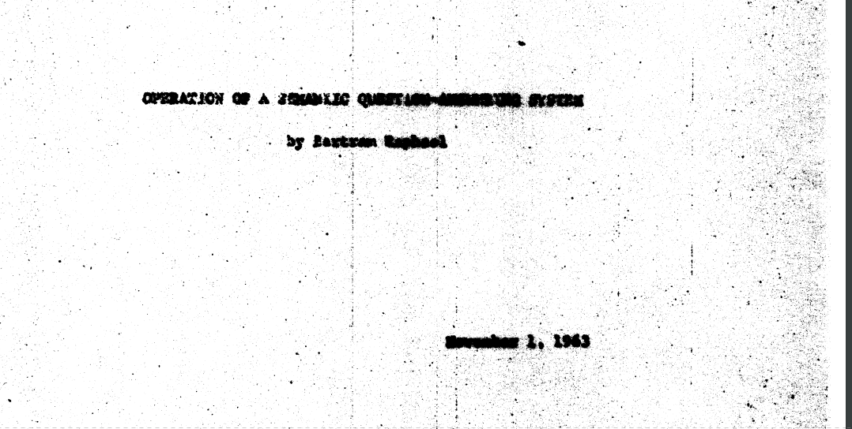

Slide 4
Basic Idea behind the Semantic System
Raphael’s paper uses database manipulations in order to create a graph and query from it. There are a set of relations between entities that have been defined in the paper. The relations have been defined such that the system is capable of handling edge cases and ambiguities.

Slide 5
Dialog System Diagram
Python Front-end
Prolog QA System (Raphael)
Natural Language dialog
The user first enters a dialog, whether it be a fact or a query.
User

Slide 6
Dialog System Diagram
Equivalent Prolog query
Python Front-end
Prolog QA System (Raphael)
Natural Language dialog
The Python front end matches the dialog against a set of regex text patterns. When matched to the appropriate command, it extracts the relevant entities from the dialog and puts them into the corresponding Prolog query. This is then queried against the Prolog system (Raphael).
User

Slide 7
Dialog System Diagram
Equivalent Prolog query
Python Front-end
Prolog QA System (Raphael)
Output from system
Natural Language dialog
The Prolog system handles the Prolog query/ operation and generates the reply.
User

Slide 8
Dialog System Diagram
Equivalent Prolog query
Python Front-end
Prolog QA System (Raphael)
Output from system
Natural Language dialog
Final output
The output from the system is cleaned up (basic formatting) and then shown to the user. This conversation continues via a series of assertions of facts and queries by the user to the system.
User

Slide 9
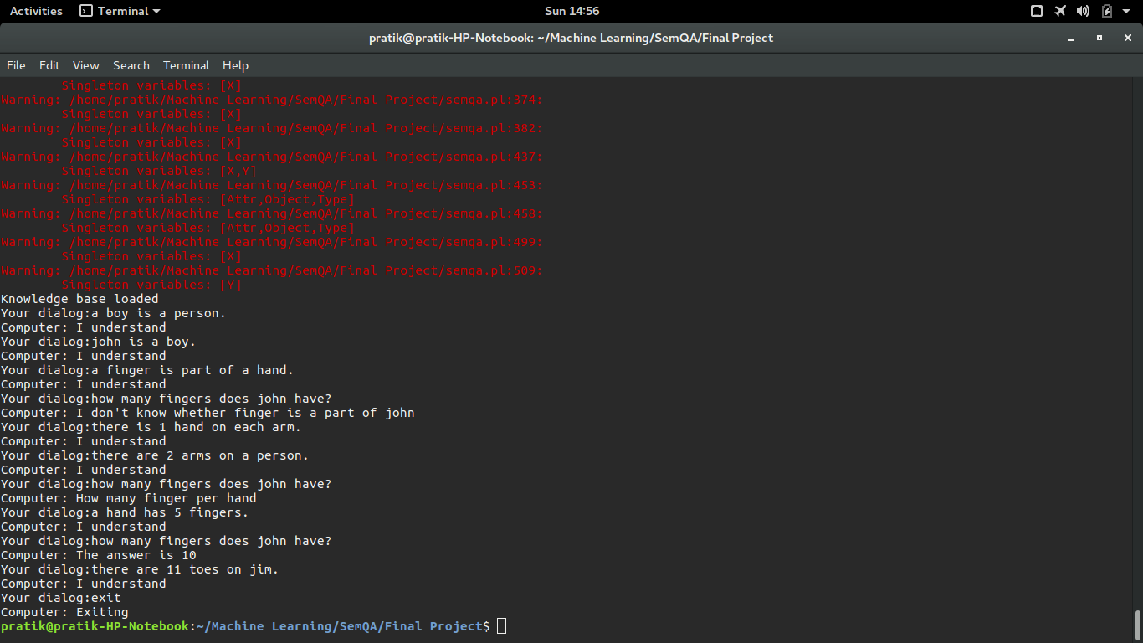
Example of Possible Dialog from Raphael’s System

Slide 10
Operations of Raphael’s System

Slide 11
Basic Relations and Graph Operations in the Raphael System
The QA system has a set of dialogs it can handle. Each type of dialog has an associated relation it establishes between entities and a graph operation it carries out. The following table shows the possible operations:

Slide 12
setr
Dialog | Relation | Prolog operation | Graph Operation
Every X is a Y. | X is a subset of Y Y is a superset of X | setr(X,Y)
Any X is an example of Y.
A X is a Y.
Subset of
X
Y
Superset of

Slide 13
2. setrq
Dialog | Query | Prolog operation
Is a X a Y? | Find chain of “subset of” links from X to Y. Return “yes” if found Else return “sometimes” if chain found in reverse direction (Y to X) Else return “insufficient” | setrq(X,Y,Answer)

Slide 14
3. setrs
Dialog | Relation | Prolog operation | Graph Operation
X is a Y. | Member X is a part of set Y Set Y has element X | setrs(X,Y)
Member of
X
Y
Has element

Slide 15
4. setrsq
Dialog | Query | Prolog operation
Is X a Y? | Query whether element X is a member of set Y Find “member of” relation from X to Y. Return “yes” if found. Else find a U which is equivalent of X such that U is “member of” Y. Return “yes” if found. Else find “member of” from X to some Z, and find chain of “subset of” from Z to Y. Return “yes” if found. Else return “insufficient” | setrq(X,Y,Answer)

Slide 16
5. setrsl
Dialog | Relation | Prolog operation | Graph Operation
The X is a Y. | The unique element U of set X also belongs to set Y. If X has more than one element, then returns a statement asking to clarify which unique element. | setrsl(X,Y,Answer)
If has unique element
X
U
Member of
U
Y
Has element

Slide 17
6. setrslq
Dialog | Query | Prolog operation
Is the X a Y? | Query whether the unique element, if any, of set X, is a member of set Y. Find the unique element U of set X, and find setrsq(U,Y,Answer). | setrslq(X,Y,Answer)

Slide 18
7. equiv
Dialog | Relation | Prolog operation | Graph Operation
X is Y | X is equivalent to Y | equiv(X,Y)
Is equivalent to
X
Y
Is equivalent to

Slide 19
8. equivl
Dialog | Relation | Prolog operation | Graph Operation
X is the Y | X is equivalent to the unique element U of set Y. If Y has more than one element, then returns a statement asking to clarify which unique element. | equivl(X,Y,Answer)
If has unique element
Y
U
Is equivalent to
U
X
Is equivalent to

Slide 20
9. ownr
Dialog | Relation | Prolog operation | Graph Operation
Every X owns a Y | Every member of set X owns some member of set Y. Every member of set Y is possessed by some member of set X. | ownr(Y,X)
Is owner of each
X
Y
Is possessed by each

Slide 21
10. ownrq
Dialog | Query | Prolog operation
Does a X own a Y? | Query whether an arbitrary member of set X owns some member of set Y Return “No, they are same” if X=Y. Else return “yes” if set X “is owner of each” set Y. Else return “yes” if some superset Z of X “is owner of each” set Y. Else return “insufficient” | ownrq(Y,X,Answer)

Slide 22
11. ownrgu
Dialog | Relation | Prolog operation | Graph Operation
X owns a Y | Individual X owns a member of set Y. | ownrgu(Y,X)
Is owner of
X
Y
Is possessed by

Slide 23
12. ownrguq
Dialog | Query | Prolog operation
Does X own a Y? | Query whether an individual X owns a member of set Y Return “yes” if some set Z “is subset of” set Y, and individual X “is owner of” some member in set Z. Else return “yes” if individual X “is member of” some set Z, set Z “is subset of “ some set U, and set U “is owner of each” set Y. Else return “insufficient” | ownrguq(Y,X,Answer)

Slide 24
13. ownrsgq
Dialog | Query | Prolog operation
Does a X own the Y? | Query whether the unique element, if any, of set Y is owned by some element of set X. Get unique element U of set Y. Return “yes” if set Y is owned by some individual W which is a member of set Z, which in turn is a subset of X. set Y, and individual X “is owner of” some member in set Z. Else return “yes” if individual X “is member of” some set Z, set Z “is subset of “ some set U, and set U “is owner of each” set Y. Else return “insufficient” | ownrsgq(Y,X,Answer)

Slide 25
14. partr
Dialog | Relation | Prolog operation | Graph Operation
A X is part of a Y. | Every element of set X is part of some element of set Y X is a subpart of each of set Y Y is a superpart of each of set X | partr(X,Y)
A X is part of every Y.
Subpart of each
X
Y
Superpart of each

Slide 26
15. partrq
Dialog | Query | Prolog operation
Is a X part of a Y? | Query whether an arbitrary element of set X is part of some member of set Y. Return “They are the same” if X=Y. Else return “yes” if some set W is “superpart of each” X and setrq(Y,W,yes) is true, or if partrq(W,Y,yes) is true. Else return “sometimes” if set W is “superpart of each” X and setrq(Y,W,sometimes) is true or if partrq(W,Y,sometimes) is true Else return “No, Y is part of X” if partrq(Y,X,yes) is true Else retrun “No, Y is sometimes part of X” if partrq(Y,X,sometimes) is true. | partrq(X,Y,Answer)

Slide 27
16. partrgu
Dialog | Relation | Prolog operation | Graph Operation
A X is part of Y. | Some element of set X is part of individual Y. | partrgu(X,Y)
Is subpart of
X
Y
Is superpart of

Slide 28
17. partrgs
Dialog | Relation | Prolog operation | Graph Operation
A X is part of the Y. | Some element of set X is part of the unique element, if any, of set Y. If Y has more than one element, then returns a statement asking to clarify which unique element. | partrgs(X,Y,Answer)
If has unique element
Y
U
Is superpart of
U
X
Is subpart of

Slide 29
18. partrguq
Dialog | Query | Prolog operation
Is a X part of Y? | Query whether some element of set X is part of the individual Y. Return “yes” if W is “subpart of” Y or an equivalent of Y, and setrq(W,Y,yes) is true, or if partrguq(W,Y,yes) is true. Return “yes” if Z is “superpart of each” X and partrguq(Z,Y,yes) is true. Return “yes” if some U is “member of” Y or equivalent of Y, and if some V is “superpart of each” X and setrq(U,V,yes) is true or partrguq(V,Y,yes) is true. Else return “insufficient” | partrguq(X,Y,Answer)

Slide 30
19. partrss
Dialog | Relation | Prolog operation | Graph Operation
The X is part of the Y. | The unique element, if any, of set X is part of the unique element, if any, of set Y. If X or Y has more than one element, then returns a statement asking to clarify which unique element. | partrss(X,Y,Answer)
If has unique element
X
U
If has unique element
Y
V
Is superpart of
V
U
Is subpart of

Slide 31
20. partrsgq
Dialog | Query | Prolog operation
Is the X part of a Y? | Query whether unique element of set X is part of some element of set Y. Find unique element of set X. Ask for clarification if it doesn’t exist. Return “yes” if some W is “superpart of” X and W or equivalent of W is “member of” Y. Return “yes” if W is “member of” some V and setrq(Y,V,yes) is true, or if some Q is “superpart of each” V and partrsgq(Y,Q,yes) is true, and setrq(Y,Q,yes) is true. Else return “insufficient” | partrsgq(X,Y,Answer)

Slide 32
21. partrn
Dialog | Relation | Prolog operation | Graph Operation
There is/are N Xs on each/a Y. | There are N elements of set X which are parts of every element of set Y | partrn(X,Y,N).
A Y has N Xs.
Subpart of each
X
Y
Superpart of each
Quantity
N

Slide 33
22. partrnu
Dialog | Relation | Prolog operation | Graph Operation
There is/are N Xs on Y. | There are N elements of set X which are parts of individual set Y. | partrnu(X,Y,N).
Subpart of
X
Y
Superpart of
Quantity
N

Slide 34
23. partrnuq
Dialog | Query | Prolog operation
How many Xs does Y have? | Query as to how many elements of set X are parts of individual Y. Follow the procedure of partrguq(X,Y,Answer), until we get the list L of links which return a “yes” response. Return “I don’t know whether X is part of Y” if the link cannot be found. For each “superpart of each” link from U to V in L, get the quantity/number attribute of the link. If for some such link, quantity/number does not exist, return “How many U per V?” Compute the product Z of all quantities of mentioned links in L, and return “The answer is Z”. | partrnuq(X,Y,Alpha,Answer)

Slide 35
24. jright
Dialog | Relation | Prolog operation | Graph Operation
The X is just to the right of the Y. | Unique element of set X (U) is located just to the right of the unique element of set Y (V). If X or Y has more than one element, then returns a statement asking to clarify which unique element. If U is already just to the right of V, mention to user. If V is to the right of U, state that the current operation is impossible. | jright(X,Y,Answer)
The Y is just to the left of the X.
If has unique element
X
U
If has unique element
Y
V
Is just left of
V
U
Is just right of

Slide 36
25. right
Dialog | Relation | Prolog operation | Graph Operation
The X is to the right of the Y. | Unique element of set X (U) is located to the right of the unique element of set Y (V). If X or Y has more than one element, then returns a statement asking to clarify which unique element. If U is already to the right of V, mention to user. If V is to the right of U, state that the current operation is impossible. | right(X,Y,Answer)
The Y is to the left of the X.
If has unique element
X
U
If has unique element
Y
V
Is left of
V
U
Is right of

Slide 37
26. rightp
Dialog | Query | Prolog operation
- | Checks whether it is known that the X is located to the right of the Y. It is true if some U is “just right of” Y, and either U=X or rightp(X,U) is true. Or it is true if some V is “right of” Y, and either X=V or there is a chain from X to V following “just right of” or “just left of”, and rightp(X,V) is true. | rightp(X,Y)

Slide 38
27. jrightssq
Dialog | Query | Prolog operation
Is the X just to the right of the Y? | Query whether the X is located just to the right of the Y. Ensure both X and Y have unique elements, otherwise prompt user to clarify. Return “yes” if the X “is just right of” Y Return “no” if rightp(Y,X) is true, or if there already exists some Z which is “just right of” Y or “just left of” X. Return “no” if rightp(X,Y) is true and X is not “right of” Y (there exists no such link). Else return “insufficient information” | jrightssq(X,Y,Answer)
Is the Y just to the left of the X?

Slide 39
28. rightssq
Dialog | Query | Prolog operation
Is the X to the right of the Y? | Query whether the X is located to the right of the Y. Ensure both X and Y have unique elements, otherwise prompt user to clarify. Return “yes” if rightp(X,Y) is true. Return “no” if rightp(Y,X) is true. Else return “insufficient information” | rightssq(X,Y,Answer)
Is the Y to the left of the X?

Slide 40
29. wheres
Dialog | Query | Prolog operation
Where is the X? | Query the locations of those objects which have been positioned w.r.t. unique element of set X. Ensure X has a unique element, otherwise prompt user to clarify. Append to answer the string “Just to the right of U” where U is “just left of” X. Append to answer the string “Just to the left of V” where V is “just right of” X. Append to answer the string “Somewhere to the right of the following …. (L)” where L is a list of all elements which are “left of” X. Append to answer the string “Somewhere to the left of the following …. (M)” where M is a list of all elements which are “right of” X. If answer is still blank (= ””) , return “No position is known”. | wheres(X,Answer)

Slide 41
30. whereg
Dialog | Query | Prolog operation
Where is a X? | Query the locations of these objects which have been positioned w.r.t. some element of set X. If X has any positional link (“just left of”, ”just right of”, “left of”, “right of”), return answer of wheres(X,Answer). Else find some U which is linked via a chain of “superpart of each” to it from X. If U has a positional link , return answer of wheres(U,Answer). Else find some U which is linked via a chain of “subset of” to it from X. If U has a positional link , return answer of wheres(U,Answer). Else find some U which is linked via a chain of “superpart of each” to it from X, and subsequently find some W which is linked via a chain of “subset of” to it from U. If W has a positional link , return answer of wheres(W,Answer). Else return “No relative position is known” | whereg(X,Answer)

Slide 42
31. locates
Dialog | Query | Prolog operation
What is the position of the X? | Query the location of the unique element of set X w.r.t. as many other objects as possible. Set an initial diagram as “ (X) “. Recursively generate immediate neighbours(“just left of”,”just right of”) and append immediate links into the brackets of X, implying its immediate neighbours (e.g. “ (W X Y Z) “). Now iterate over the immediate neighbourhood and generate distant neighbours(“left of”, “right of”), and for each distant neighbour, generate immediate neighbours recursively as done for X (e.g. “ (T U) (V) (W X Y Z) (A B) “ ). Repeat until no distant neighbours remain. | locates(X,Answer)

Slide 43
Graph Building with Raphael’s System

Slide 44
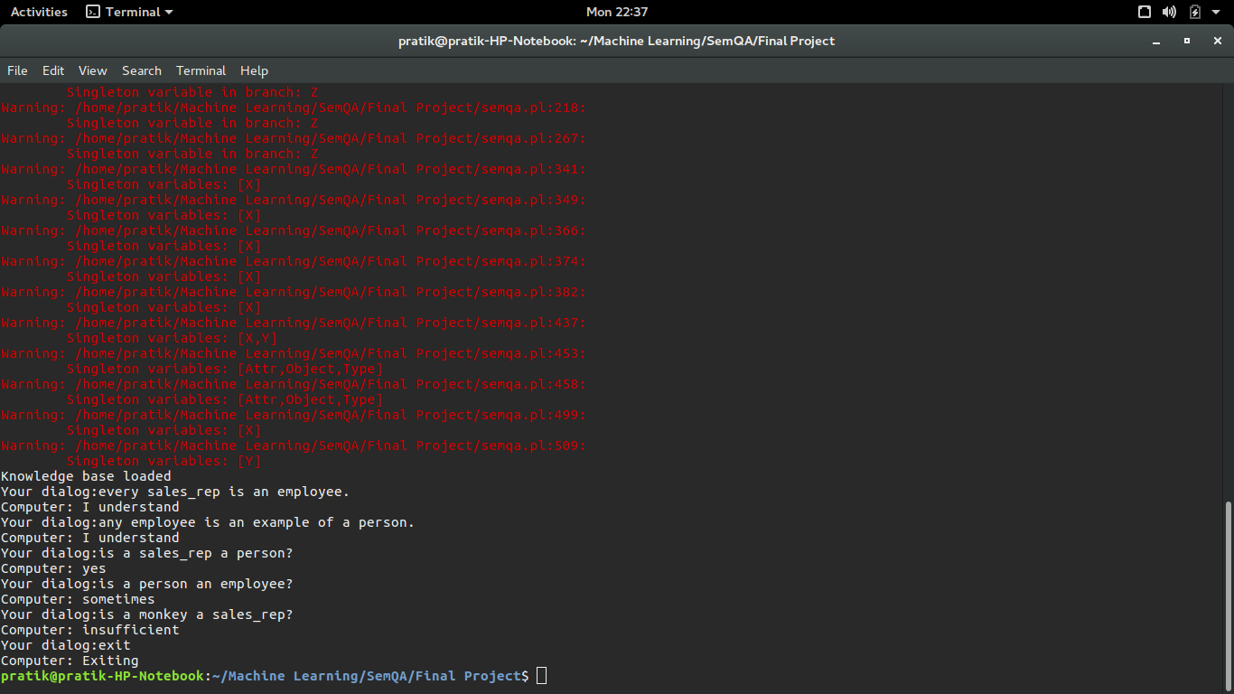
Example 1
1
2
3
4
5

Slide 45
Dialog 1
sales_rep
Subset of
Employee
Superset of
Python interface:
Create nodes
Dialog: Every sales_rep is an employee.
Matched Regex: every (.+?) is an? (.+?)\.
Equivalent Prolog fact: setr( sales_rep , employee )

Slide 46
Dialog 2
sales_rep
Subset of
Employee
Superset of
Subset of
Superset of
Person
Python interface:
Dialog: Any employee is an example of a person.
Matched Regex: any (.+?) is an example of an? (.+?)\.
Equivalent Prolog fact: setr( employee , person )
Create node

Slide 47
Dialog 3
sales_rep
Subset of
Employee
Superset of
Subset of
Superset of
Person
Python interface:
Dialog: Is a sales_rep a person?
Matched Regex: is an? (.+?) an? (.+?)\?
Equivalent Prolog query: setrq( sales_rep , person , X)
X = yes

Slide 48
Dialog 4
sales_rep
Subset of
Employee
Superset of
Subset of
Python interface:
Superset of
Dialog: Is a person an employee?
Matched Regex: is an? (.+?) an? (.+?)\?
Equivalent Prolog query: setrq( person , employee , X)
X = sometimes
Person
In this case, setrq(person,girl,yes) is false, but setrq(girl,person,yes) is true, which means setrq(person,girl,sometimes) is true. This is how ambiguity is handled in terms of set relations by Raphael’s paper.

Slide 49
Dialog 5
sales_rep
Subset of
Employee
Superset of
?
Subset of
Superset of
Monkey
Person
Python interface:
Dialog: Is a monkey a sales_rep?
Matched Regex: is an? (.+?) an? (.+?)\?
Equivalent Prolog fact: setrq( monkey , sales_rep , X)
X=insufficient

Slide 50
Example 2
1
2
3
4
5
6
7
8
9

Slide 51
Dialog 1
Subset of
boy
person
Superset of
Create nodes
Python interface:
Dialog: a boy is a person.
Matched Regex: a (.+?) is an? (.+?)\.
Equivalent Prolog fact: setr( boy , person )

Slide 52
Dialog 2
Member of
Subset of
john
boy
person
Has element
Superset of
Create node
Python interface:
Dialog: john is a boy.
Matched Regex: (.+?) is an? (.+?)\.
Equivalent Prolog fact: setrs( john , boy )

Slide 53
Dialog 3
Member of
Subset of
john
boy
person
Has element
Superset of
Subpart of each
finger
hand
Superpart of each
Python interface:
Create nodes
Dialog: a finger is part of a hand.
Matched Regex: an? (.+?) is part of an? (.+?)\.
Equivalent Prolog fact: partr( finger , hand )

Slide 54
Dialog 4
Member of
Subset of
john
boy
person
Has element
Superset of
?
Subpart of each
finger
hand
Superpart of each
Python interface:
In this query, the system is unable to find the appropriate connection (subpart of relation) between finger and john, therefore this ambiguity is handled by a return dialog statement making it clear to the user that it is unable to find the link.
Dialog: how many fingers does john have?
Matched Regex: how many (.+?)s does (.+?) have\?
Equivalent Prolog query: partrnuq( finger , john , X , Y )
X = 0
Y = “I don’t know whether finger is part of john”

Slide 55
Dialog 5
Member of
Subset of
john
boy
person
Has element
Superset of
Subpart of each
Subpart of each
finger
hand
arm
Superpart of each
Superpart of each
Quantity
1
Python interface:
Create node
Dialog: there is 1 hand on each arm.
Matched Regex: there (is|are) (\d+?) (.+?)s? on (each|a) (.+?)\.
Equivalent Prolog fact: partrn( hand , arm , 1 )

Slide 56
Dialog 6
Member of
Subset of
john
boy
person
Has element
Superset of
Superpart of each
Subpart of each
2
Quantity
Subpart of each
Subpart of each
finger
hand
arm
Superpart of each
Superpart of each
Quantity
1
Python interface:
Dialog: there are 2 arms on a person.
Matched Regex: there (is|are) (\d+?) (.+?)s? on (each|a) (.+?)\.
Equivalent Prolog fact: partrn( arm , person , 2 )

Slide 57
Dialog 7
Member of
Subset of
john
boy
person
Has element
Superset of
Superpart of each
Subpart of each
2
Quantity
Subpart of each
Subpart of each
finger
hand
arm
Superpart of each
Superpart of each
?
Quantity
Python interface:
1
In this case, the links are established, but the relevant quantity is missing. This quantity is prompted by the system.
Dialog: how many fingers does john have?
Matched Regex: how many (.+?)s does (.+?) have\?
Equivalent Prolog query: partrnuq( finger , john , X , Y )
X = 0
Y = “how many finger per hand”

Slide 58
Dialog 8
Member of
Subset of
john
boy
person
Has element
Superset of
Superpart of each
Subpart of each
2
Quantity
Subpart of each
Subpart of each
finger
hand
arm
Superpart of each
Superpart of each
Quantity
Quantity
5
1
Python interface:
Dialog: a hand has 5 fingers.
Matched Regex: an? (.+?) has (\d+?) (.+?)s\.
Equivalent Prolog fact: partrn( finger , hand , 5 )

Slide 59
Dialog 9
Member of
Subset of
john
boy
person
Has element
Superset of
Superpart of each
Subpart of each
2
Quantity
Subpart of each
Subpart of each
finger
hand
arm
Superpart of each
Superpart of each
Quantity
Quantity
5
1
Python interface:
5*1*2 = 10
Dialog: how many fingers does john have?
Matched Regex: how many (.+?)s does (.+?) have\?
Equivalent Prolog query: partrnuq( finger , john , X , Y )
X = 10
Y = “the answer is 10”

Slide 60
Extension to Clark’s work

Slide 61
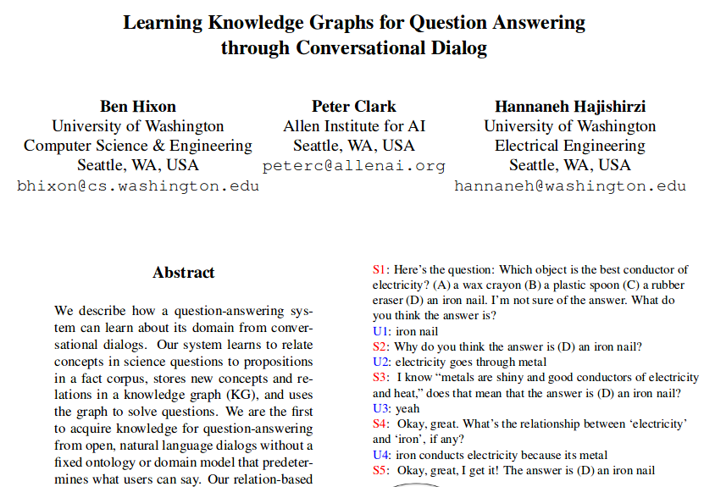

Slide 62
“Learning Knowledge Graphs for Question Answering through Conversational Dialog” (Hixon, Clark, Hajishirzi)
This paper’s novel methodology involves creating a QA system which is learns a knowledge-graph with open, natural language dialogs with the user. Through user correction and conversation, the system learns semantic relations and creates a knowledge graph for the particular domain of discussion (without creating domain-specific model which limits dialogs). In the paper, examples involving basic scientific discussions are used frequently, and the paper stresses that their system is more effective at solving science questions compared to relation generation from general knowledge sources. The paper states that their methodology is capable of being generalized to other domains.

Slide 63
Extending our system to Clark’s work
Clark’s work demonstrates great performance on solving science questions. In order to extend our system in that direction, we can either:
Attempt to solve science questions following the principles of Raphael’s work, which will be done by a manual extension of our QA system.
Accommodate Clark’s knowledge-graph learner by reconstructing our QA system to accept generalized dialogs.

Slide 64
Manual extension of Raphael’s System
In order for our system to better solve science questions, we would need to:
Analyze scientific conversations involving questions and answers. We would need to limit ourselves to simple scientific discussion.
Come up with a set of fixed scientific dialogs which are used most often.
Manually create the logical procedures for the operations that these dialogs correspond to.
Extend the Prolog system manually by encoding these rules.
Extend the Python front-end so that it is able to parse the set of dialogs.
We extended our QA system in this manner to accommodate some scientific dialog. Relevant examples are shown in later slides.

Slide 65
Manual extension of Raphael’s System
Some possible dialogs we could incorporate:
X is a good/medium/bad conductor of Y.
Which among the following is the best conductor of X:A,B,C?
A property of X is that it is Y.
List the properties of X.
The value of X (any scientific constant, e.g. Young’s modulus) for Y (any material) is N (value of the scientific constant).
Calculate X (e.g. stress,force,acceleration) for Y with the variable values: Var1->Val1,Var2->Val2,..

Slide 66
Manual extension of Raphael’s System
Advantages:
Extension follows the same standardized process which is outlined in Raphael’s work, extension is more simple to do.
The system remains deterministic, and yields accurate dialog. The knowledge graph generated will be meaningful, and there are no errors made by the QA system unless the operations are wrongly modeled.
Advanced operations/queries can be done by the user, since complex operations are manually modeled.
Disadvantages:
This follows the essence of Raphael’s paper, but not of Clark’s paper, which aims to create a generalized model. Moreover, we will not be accommodating Clark’s knowledge-graph learner, but merely adopting the domain-specific task they have performed well in.
The extended system will only work for a fixed set of dialogs that we have decided. Any variation in dialog will not be recognized.
The model is highly domain-specific, and not easily scalable to other domains.

Slide 67
2. Accommodating Clark’s knowledge-graph learner
In order to accommodate the knowledge-graph learner, the new dialog system diagram would be as below:
Modified Python Front-end
Raphael’s Prolog QA System
Conversation/Dialog Learner
Knowledge-graph learner
User

Slide 68
2. Accommodating Clark’s knowledge-graph learner
Clark’s knowledge-graph learner is able to model advanced semantic relations which may appear as different dialogs. To accommodate this, we would have to add the following:
Conversation/Dialog Learner
Modified Python front-end
Knowledge-graph learner

Slide 69
2. Accommodating Clark’s knowledge-graph learner
Conversation/Dialog Learner:
This learns dialogs which are not familiar to the current system. It learns to parse the dialogs and extract the relevant entities and relations. This could be a sequence-to-sequence neural model with hierarchical attention, as is frequently in many dialog engines. Its main role is to learn the linguistic structure of a new dialog, and allow the Python front-end to parse it.

Slide 70
2. Accommodating Clark’s knowledge-graph learner
2. Modified Python front-end:
The Python front-end should now allow all diverse kinds of dialogs, and should no longer be a regex parser. It infers the kind of dialog being passed through (is it a question,statement, relevant concepts and entities). It is informed by the conversation/dialog learner module about how to do so.

Slide 71
2. Accommodating Clark’s knowledge-graph learner
3. Knowledge-graph Learner:
This module should be able to associate relevant relations and concepts together, and learn how certain relations function with respect to related entities. It should recognize the most important/relevant relations between concepts (as stated in the paper). Moreover, it should be able to learn the operations associated with a relation and that should be translated into Prolog (e.g. how an operation like “conductor of” builds the graph up should be learnt and translated into Prolog) and added to Raphael’s Prolog System.

Slide 72
2. Accommodating Clark’s knowledge-graph learner
Advantages:
A more wider range of relations and concepts can be stored and built up in the knowledge base.
The system will be able to accept a larger set of possible dialogs, and map linguistically different dialogs with same intent onto the same relations and associated concepts.
This follows the essence of Clark’s paper, and doesn’t restrict dialogs to a limited set, and creates a domain-independent model.
Disadvantages:
Complex operations will be difficult to model. The knowledge-graph learner will need a good number of clean dialogs (training data) to realize the dynamics of the operation and translate it into Prolog.
Diverse dialogs will require more data to be recognized, and the system will no longer be deterministic. There will be a chance that operations are incorrectly modeled, therefore the quality of training data becomes of paramount importance.

Slide 73
Sample Dialogs from “Learning Knowledge Graphs for Question Answering through Conversational Dialog”
Following are a few dialogs which extend Raphael’s work to adapt to a more modern dialog involving basic scientific discussion. No restructuring is done here, and just a manual extension is implemented.

Slide 74
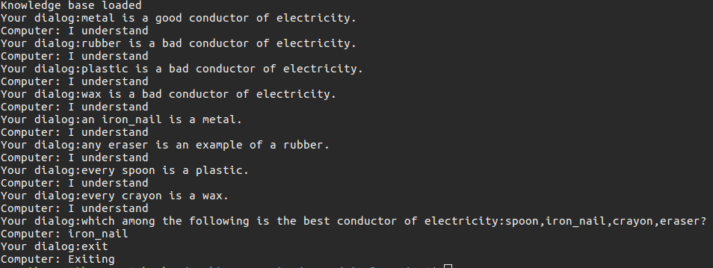

Slide 75
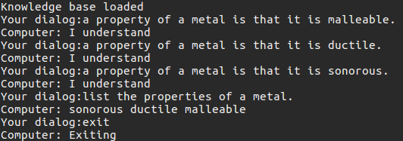

Slide 76
Appendix: Some Sample Dialogs from Raphael’s Reconstructed System

Slide 78
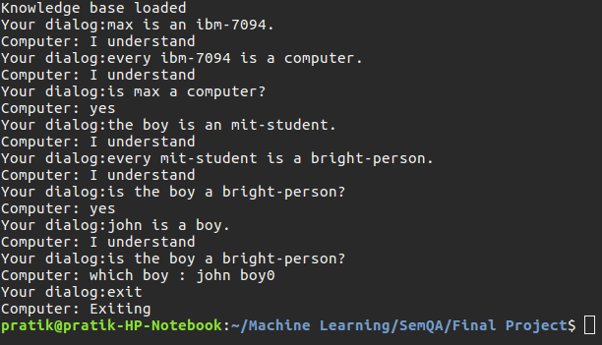

Slide 79
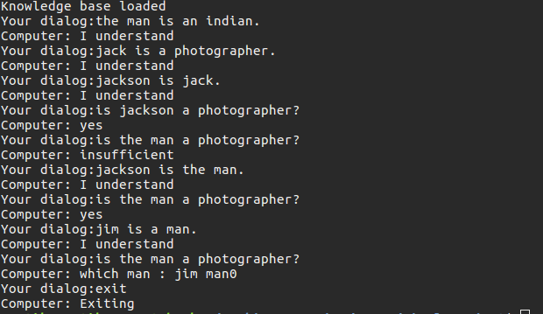

Slide 80
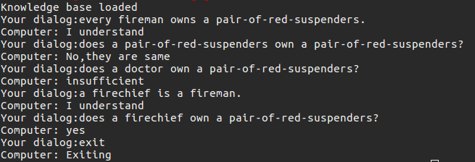

Slide 81
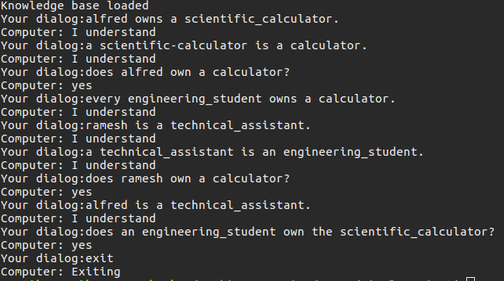

Slide 82
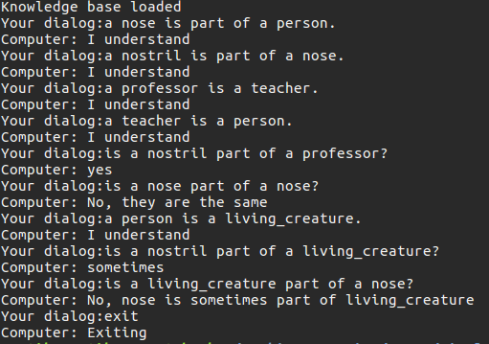

Slide 83
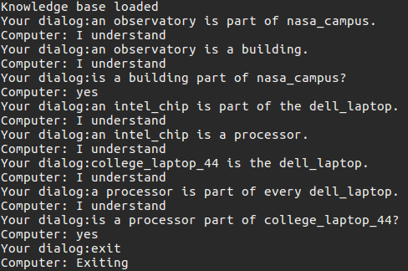

Slide 84
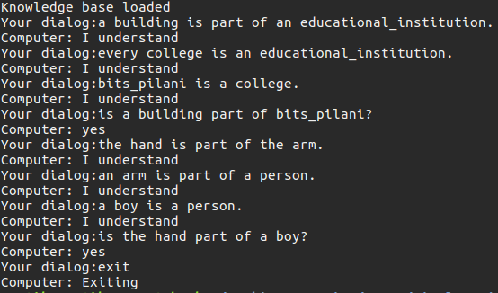

Slide 86
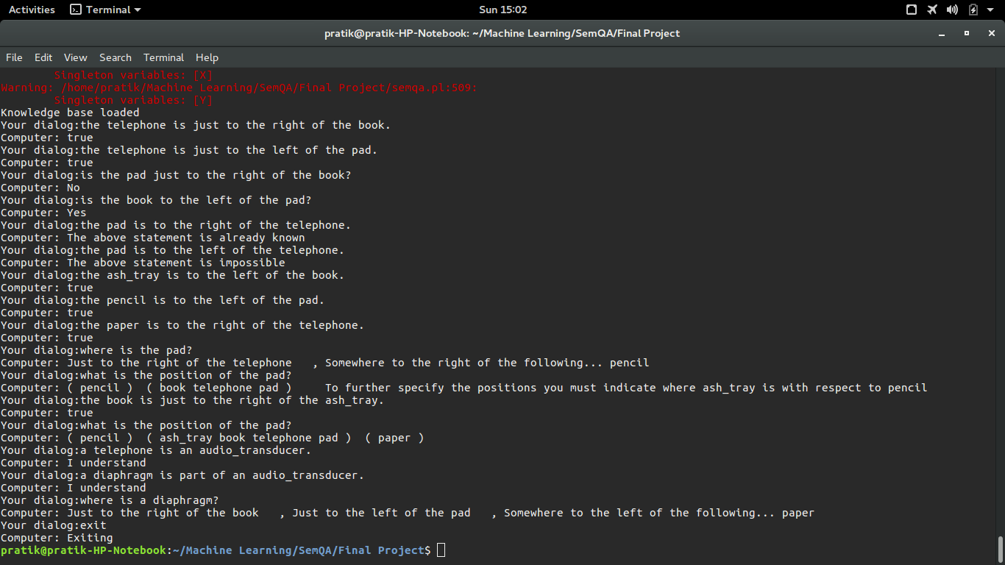

Slide 87
Continued from previous slide

